Slide 1




Tackling the 9th SDG: A Project for a Sustainable Future
The 9th Sustainable Development Goal (SDG) focuses on building resilient infrastructure, promoting inclusive and sustainable industrialization, and fostering innovation. This presentation outlines a project that directly addresses this SDG, aiming to create a positive impact on the world.
by Ian Musyoki

Slide 2

Overview of the Project
This project aims to bridge the digital divide by providing access to technology and digital literacy skills for underprivileged communities.
Digital Literacy Training
Affordable Technology Access
Providing hands-on training in basic computer skills, internet usage, and online safety.
Offering subsidized or free devices, internet connectivity, and software to empower individuals.
Community Hubs
Establishing community centers equipped with computers and internet access, fostering collaboration and knowledge sharing.

Slide 3

Addressing the 9th SDG
This project directly contributes to SDG 9 by promoting inclusive and sustainable industrialization, fostering innovation, and creating a more equitable society through technology.
1
Promoting Sustainable Industrialization
2
Fostering Innovation
Access to technology and digital skills enables individuals to explore new opportunities, participate in the digital economy, and contribute to technological advancements.
By empowering individuals with digital skills, the project fosters innovation and supports the development of a sustainable and inclusive digital economy.
3
Reducing Inequality
Bridging the digital divide helps level the playing field, creating equal opportunities for all individuals to access education, employment, and social resources.

Slide 4
Key Features of the Project
This project is designed with a comprehensive approach, addressing multiple aspects of the digital divide.
Tailored Training Programs
Community-Based Approach
Sustainable Partnerships
Training modules are tailored to the specific needs and learning styles of participants, ensuring effectiveness and relevance.
Collaborating with local businesses, NGOs, and educational institutions to ensure long-term sustainability and impact.
Project implementation is deeply rooted in local communities, leveraging existing resources and fostering community engagement.

Slide 5

Target Audience and Market Analysis
The project primarily targets underserved communities with limited access to technology and digital skills.
Target Group
Characteristics
Needs and Challenges
Low-income individuals
Limited access to technology, lower levels of education
Need for affordable technology, digital skills training, and job opportunities
Rural communities
Limited infrastructure, lack of internet connectivity
Need for infrastructure development, digital literacy programs, and remote job opportunities
Refugees and displaced persons
Lack of formal education, limited access to resources
Need for language training, digital literacy programs, and integration into new communities

Slide 6




Competitive Landscape and Unique Value Proposition
Several organizations focus on digital inclusion, but this project differentiates itself by emphasizing a holistic approach.
Community-Centric Approach
Holistic Program Design
Sustainable Partnerships
Prioritizing community needs and leveraging existing local resources for maximum impact.
Addressing not only digital literacy but also providing access to affordable technology and supporting job opportunities.
Fostering long-term collaboration with local organizations to ensure sustainability and continuous improvement.

Slide 7
Business Model and Revenue Streams
The project is designed to be financially sustainable through a mix of funding sources and revenue streams.
Grants and Donations
Corporate Partnerships
Social Enterprises
Securing funding from philanthropic organizations and government agencies committed to social impact.
Collaborating with businesses that prioritize social responsibility and seek to invest in digital inclusion initiatives.
Developing social enterprises that provide job opportunities for program graduates and generate revenue for the project.

Slide 8
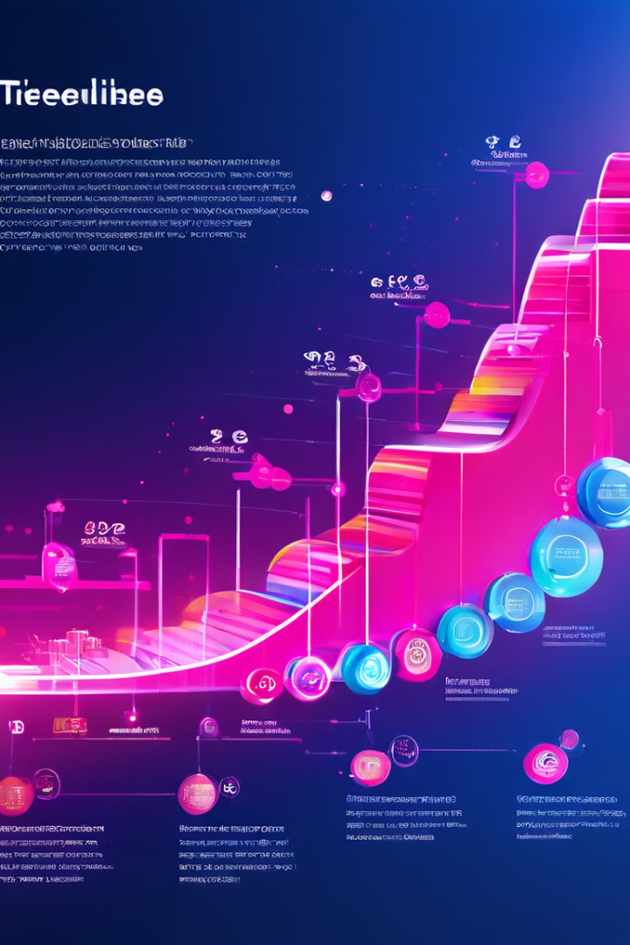
Milestones and Roadmap
The project is implemented in phases, with clear milestones and a detailed roadmap to ensure effective execution.
1
Phase 1: Pilot Program Launch
Launching a pilot program in a selected community to test and refine the program model.
2
Phase 2: Program Expansion
Scaling up the program to reach more communities and establish sustainable partnerships.
3
Phase 3: Regional Network Development
Establishing a network of community centers and partnerships across multiple regions, fostering collaboration and knowledge sharing.

Slide 9




Team and Advisors
The project is led by a team of passionate individuals with expertise in technology, education, community development, and social impact.
Strong Network
Leveraging a network of experts, partners, and advisors to ensure project success.
Collaborative Approach
Working closely with local communities and stakeholders to ensure program relevance and impact.
Innovative Solutions
Developing creative and effective solutions to address the unique challenges faced by target communities.

Slide 10

Funding Requirements and Use of Proceeds
The project requires funding to support program implementation, technology acquisition, and infrastructure development.
Funding Requirement
Use of Proceeds
$1 million
Program development and implementation
$500,000
Technology acquisition and infrastructure development
$250,000
Marketing and outreach activities

